Slide 1


Arrangement and Description:
Fundamentals
Pam Hackbart-Dean
Susan Potts McDonald
Day 1: Arrangement
©2016 Society of American Archivists

Slide 2
Arrangement & Description(A&D)
SAA Curriculum and Certificate Program:
Foundational Courses—must pass 3
  Arrangement and Description: Fundamentals; AND Describing Archives: A Content Standard (DACS) are required.
  Tactical and Strategic Courses—must pass 3
  Copyright Issues in Digital Archives OR Confidentiality and Privacy Issues in Digital Archives are required.
  Tools and Services Courses—must pass 1
  Transformational Courses—must pass 1
  Course examinations are administered online.
Notes:
*

Slide 3
Introduce Yourself
My name is…
I’m from…
My job is…
Hope to learn

Slide 4
Workshop Objectives
Understand the concepts and principles of arrangement;
Apply the common arrangement of various types of collections and material formats;
Identify the essential elements of a finding aid;
Describe the major standards supporting these elements;
Identify basic tools that can be employed to facilitate management of arrangement and description; and
Demonstrate an understanding of best practice

Slide 5
Goals of Arrangement
Arrangement: Process of physically organizing materials
  Determining intellectual placement
  Examining the records to determine existing order and devise work plan
  Processing or physical arrangement

Slide 6
Goals of Description
Description: Establish the intellectual control of a collection
Recording information about the nature and content
Creation of descriptive tools

Slide 7
Goals of Arrangement & Description
Happy Medium
Compromise between access and staff time and resources
Good access without spending inordinate amounts of time

Slide 8
Terminology

Slide 9
Principles of Arrangement:
Respect des fonds
“the records created, assembled, accumulated, and/or maintained and used by an organization or individual must be kept together in their original order if it exists or has been maintained, and not be mixed or combined with the records of another individual or corporate body.” [DACS]

Slide 10
Principles of Arrangement: Provenance
“the relationships between records and those who created, accumulated, maintained or used them in the conduct of personal or corporate activity.” [DACS]

Slide 11
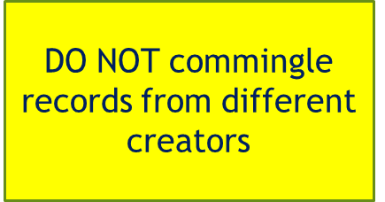
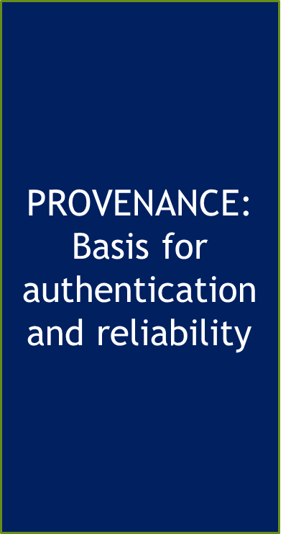
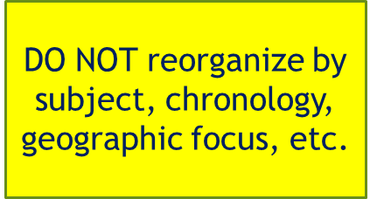

Provenance: Things to consider
DO NOT remove correspondence from one collection and move to another

Slide 12
Principles of Arrangement:
Original order
“the order of the records that was established by the creator should be retained whenever possible to preserve existing relationships between the documents and the evidential value inherent in their order.” [DACS]

Slide 13
Original order: Things to consider
Maintain records in the order in which they were created, received, filed or used
Look for evidence of a pre-existing arrangement, devised by the creator
Preserving relations among the records and to respect context in which the records came to be

Slide 14

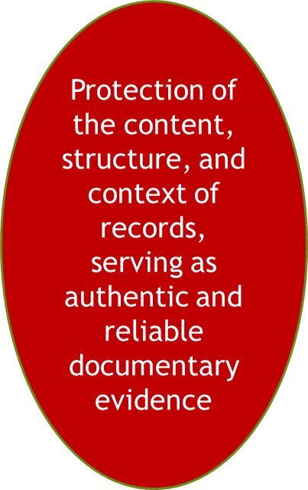


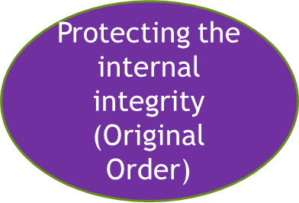

Slide 15



Nature of the archival unit

Slide 16
Analog vs. Born-Digital records
Material type | Analog formats | Digital formats
Architectural records | Blueprints, evaluations, renderings | Computer-aided design (CAD) files
Audio recordings | Tapes, LPs, wax cylinders | CDs, digital sound files
Correspondence | Letters, postcards | Emails, word processing files, social media
Data | Lab notebooks, logbooks | Spreadsheets, database
Institutional records | Typed or print documents | Word processing files, PDFs, databases
Manuscripts | Handwritten or typed documents, diaries | Word processing files, Facebook posts, blogs
Moving images | Film, video | DVDs, digital video files
Photographs | Film-based media such as prints, negatives, slides | Digital image files, Flickr, Instagram photos
Publications | Brochure, newsletters, reports | Websites, desktop publishing files

Slide 17
Oliver W. Holmes’ Five Levels of Control
The hierarchical, intellectual, and physical divisions used in archives management:
Repository
Record Group/Collection
Series
File
Item

Slide 18
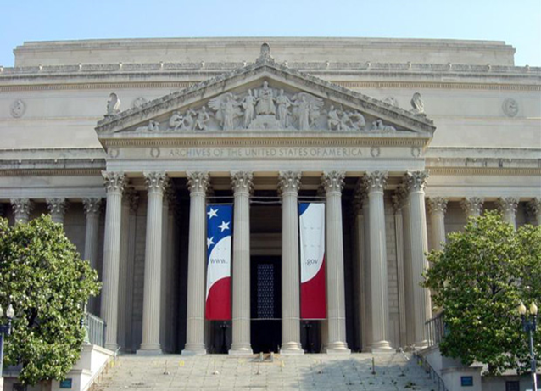
Repository
Simply the archives itself
Stuart A. Rose Manuscript, Archives, Rare Books Library
John F. Kennedy Presidential Library & Museum
Special Collections Research Center, Southern Illinois University Carbondale

Slide 19
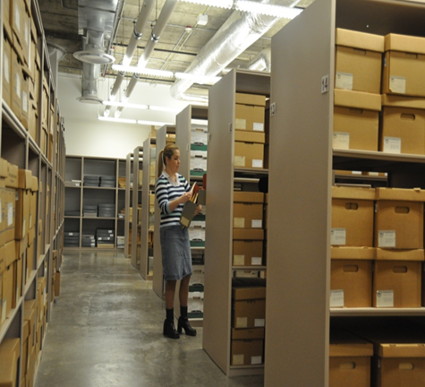
Record Group/Collection
Record Group
  Public or corporate material
    Cook County (Ill.) county auditor records
Collection
  Personal papers
    John Marshall papers
Contains only material created by, received by or pertaining directly to one distinct group

Slide 20
Series
A grouping of records according to their use
Organized according to specific functions or activities
Common types include:
  Minutes
  Correspondence
  Diaries
  Photographs
  Printed materials

Slide 21
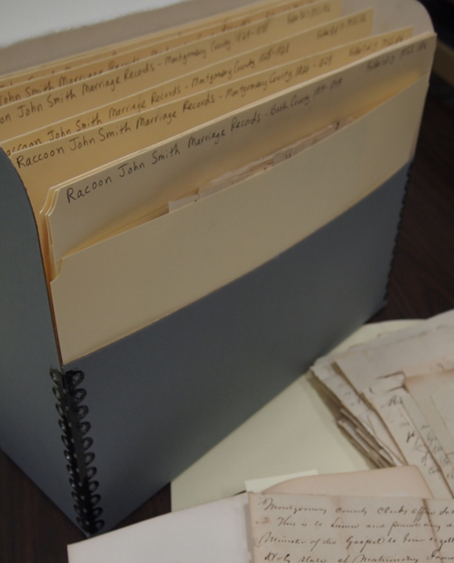
File
Grouping materials together in one file folder
Maintain file systems as long as discernible and consistent
Date, alphabetically, subject, numerically

Slide 22
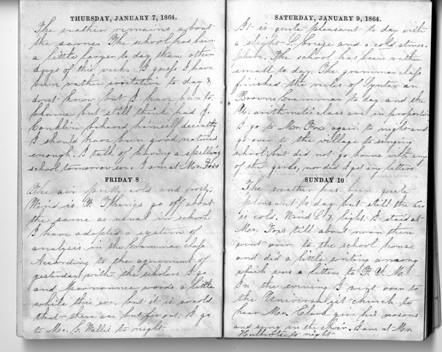
Item
Simply the individual record—the letter, map, journal, etc.
Filed chronologically, alphabetically, geographically or by physical needs
Ben Wiley diary, 1864

Slide 23
Levels example: Personal papers
Repository: Manuscript Collection
  Collection: Ted Hughes papers
    Series: Correspondence
      Subseries: Alphabetical correspondence files
        File: Adams-Catlin
          Item: Adams, James to Ted Hughes, March 14, 2001

Slide 24
Levels example: Archives
Repository: State Government Records
Record Group: Office of the Governor
Series: Governor Sherman Oaks schedules and appointment files
Subseries: Schedules
File: November-December 1981
Item: Schedule for November 11, 1981

Slide 25
Processing

Slide 26
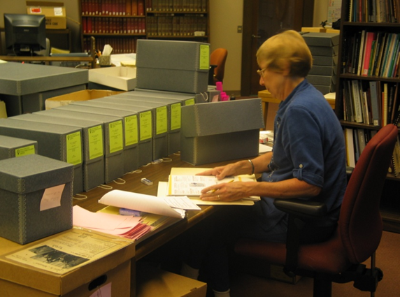
Preparing for arrangement
Processing work plans
Processing checklist
Estimating processing rate

Slide 27
Notification of processing
Email staff
Finding aid
Shelf list
MARC and EAD records
Update records
Notify donor

Slide 28
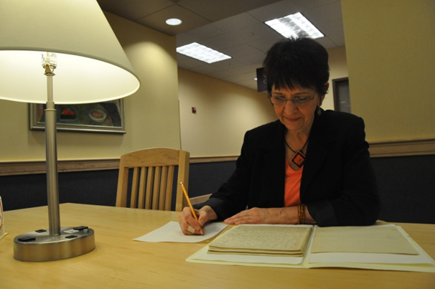
Preliminary research
Gather & analyze information
Reference sources
  Dealer/donor
  Published works
  Your library’s electronic resources
  Internet resources

Slide 29
Determining Series/Subseries
  Use series for large collections
    Grouping of records according to:
      Physical type,
      Subject,
      Filing unit
  Series may contain subseries

Slide 30
Salman Rushdie papers
Series 1: Journals, appointment books, and notebooks
Series 2: Writings by Rushdie
Subseries 2.1: Fiction
Subseries 2.2: Nonfiction
Subseries 2.3: Scripts
Subseries 2.4: Other writings
Series 3: Writing by others
Subseries 3.1: Writings about Rushdie
Subseries 3.2: Other writings
Series 4: Correspondence
Subseries 4.1: Family correspondence
Subseries 4.2: General correspondence
Subseries 4.3: Literary agent correspondence

Slide 31
Series 5: Personal papers
Subseries 5.1: Financial records
Subseries 5.2: Legal papers
Subseries 5.3: Family papers
Series 6: Subject files
Series 7: Photographs
Subseries 7.1: Salman Rushdie
Subseries 7.2: Other people and places
Subseries 7.3: Slides and negatives
Subseries 7.4: Family photographs
Series 8: Printed material
Subseries 8.1: Printed material by Rushdie
Subseries 8.2: Printed material about Rushdie
Subseries 8.3: General printed material
Series 9: Audiovisual
Subseries 10.1: Audio recordings
Subseries 10.2: Video recordings

Slide 32
Birdwatchers of America records
Correspondence
1970-1975
1976-1980
1981-1995
Minutes
1910-1930
1940-1960
1970-1990
Scrapbooks
Indigo Buntings
Scarlet Tanagers
Cedar Waxwings

Slide 33
Common Arrangement Schemes

Slide 34
Common Arrangement Schemes: Personal/Family papers
Audiovisual materials
Correspondence
Diaries/Journals
Ephemera
Financial records
Genealogical records
Legal documents
Organizational files
Photographs
Printed materials
School records
Scrapbooks
Subject files
Writings

Slide 35
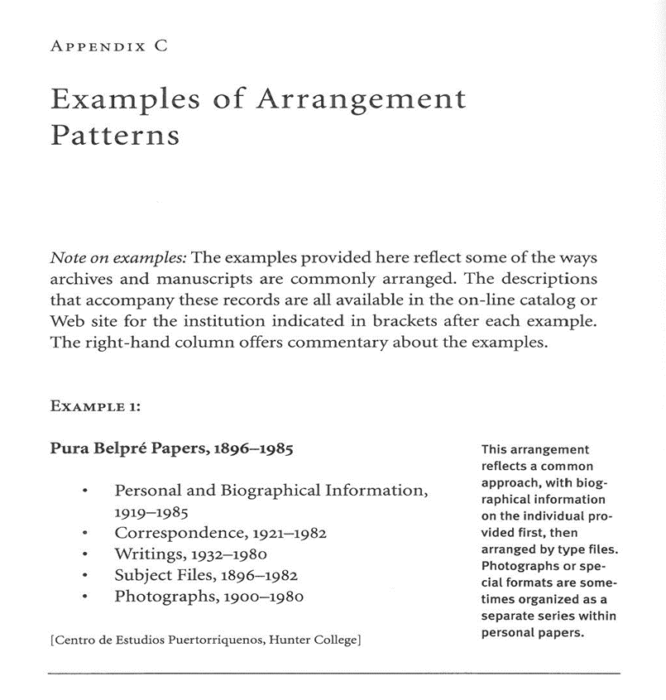
Personal Papers

Slide 36
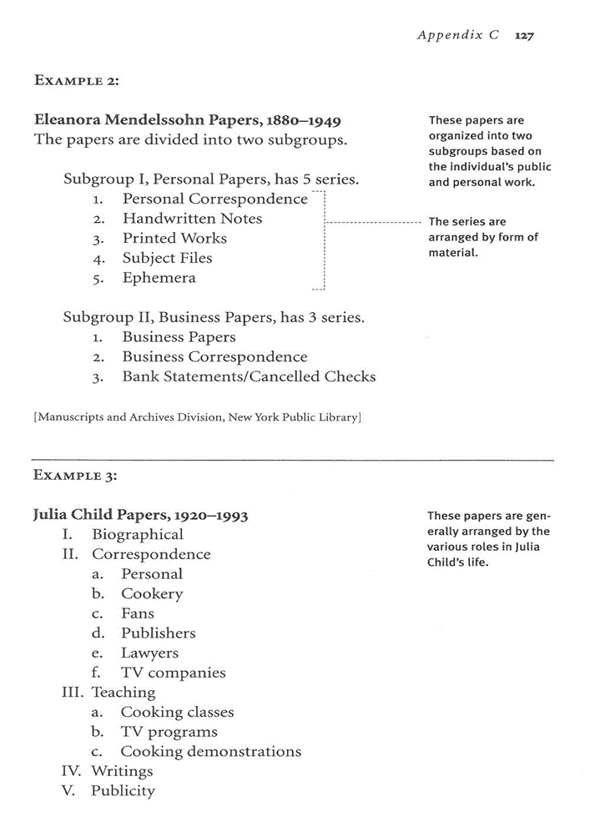

Slide 37
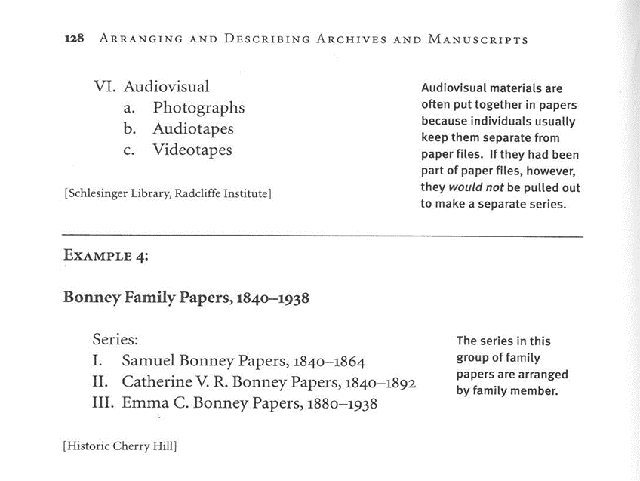

Slide 38
Exercise #1
Personal papers

Slide 39
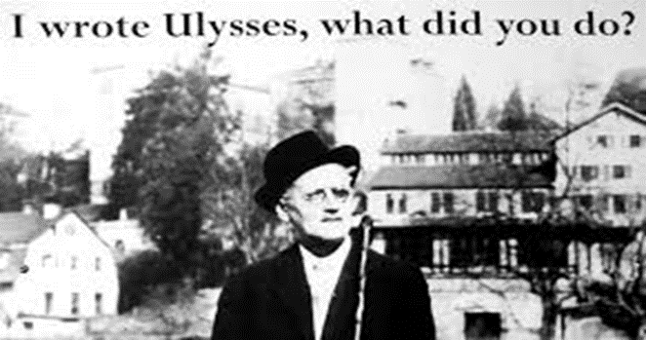
Common Arrangement Schemes: Literary Papers
Audiovisual materials (audio and video recordings)
Correspondence
Ephemera
Financial records (relating to the business of writing)
Writings [manuscript and typescript]
Printed material [published]
Photographs
Subject file

Slide 40


Common Arrangement Schemes: Organizational/Business Records
Administrative records
Advertising records
Audio-visual materials
Committee files
Correspondence
Financial records
Legal records
Meeting files
Minutes
Personnel records
Photographs
Public relations files
Subject files

Slide 41
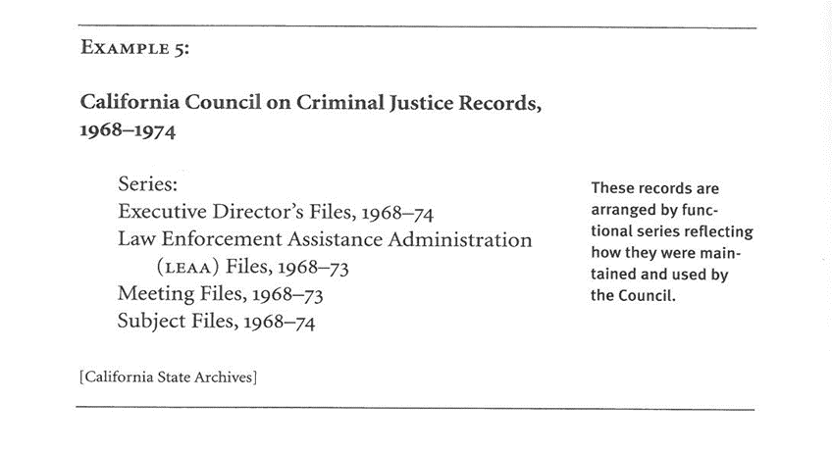
Corporate Records

Slide 42
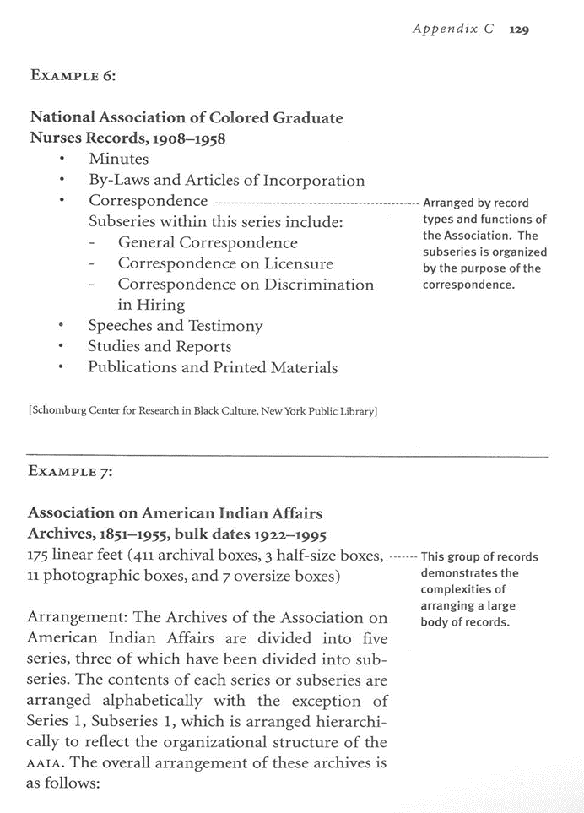

Slide 43
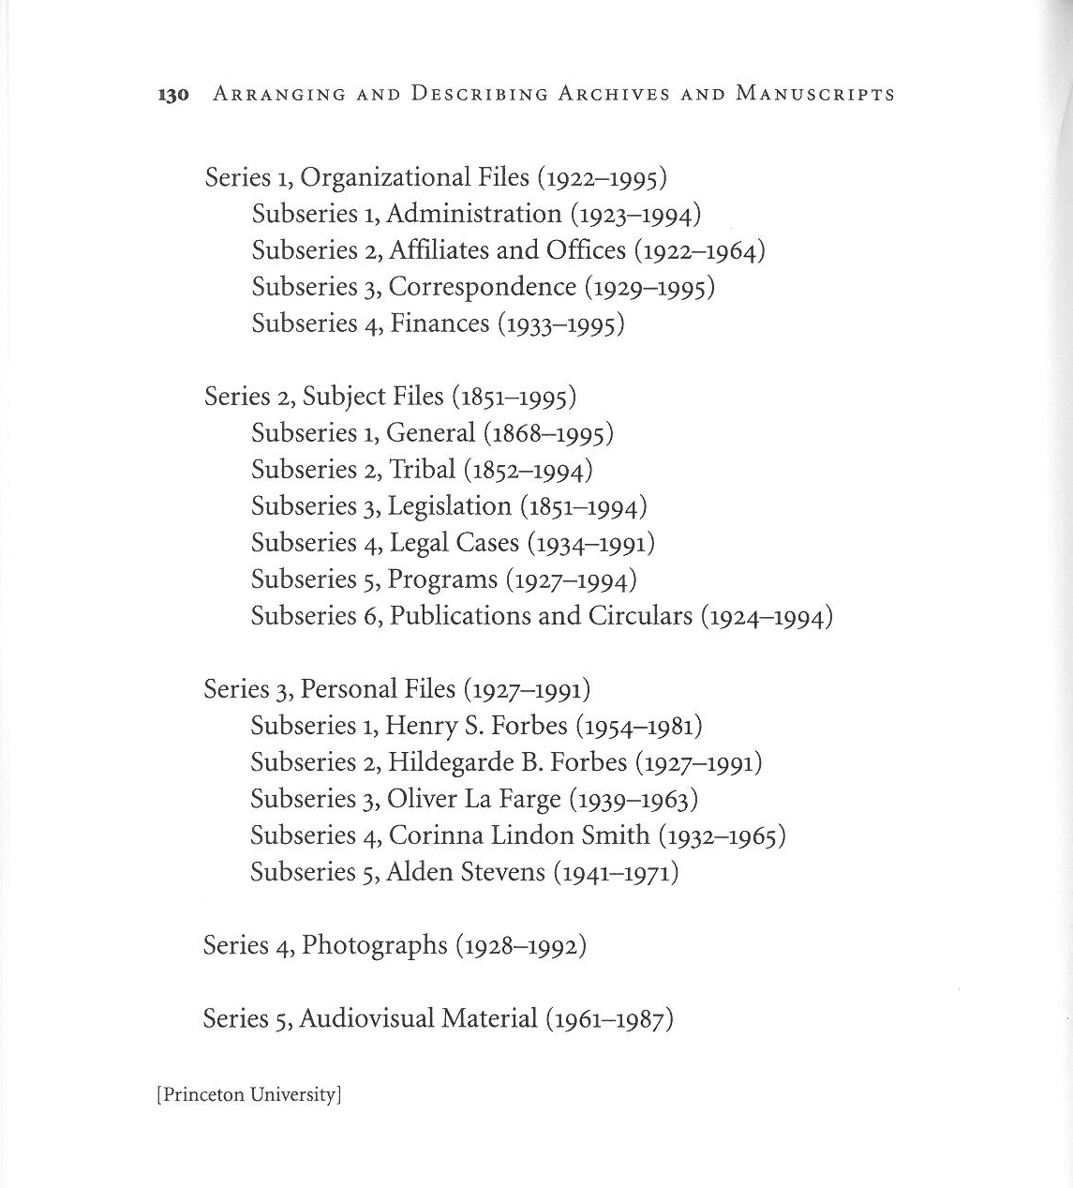

Slide 44
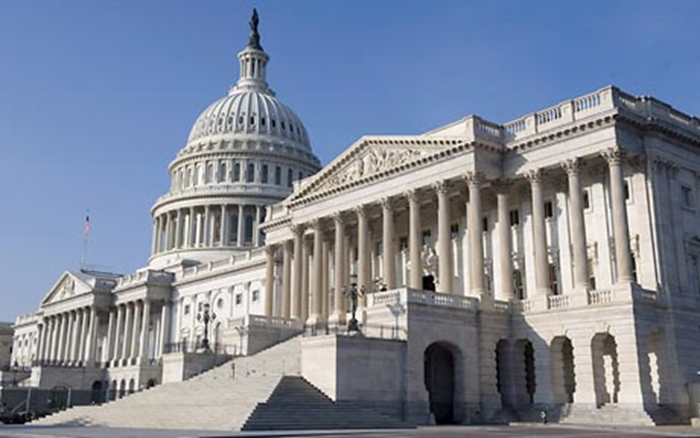
Common Arrangement Schemes: Legislative Papers
Karen Paul, Records management handbook for United States Senators and their repositories, 2006.

Slide 45
Exercise #2
Organizational records

Slide 46
Specific Record Types

Slide 47

Specific Record Types: Audiovisual
Sound recordings
  Audio cassettes
  Compact disks
  Reel-to-reel tapes
  Phonograph records
Motion picture films
Videocassettes
Digital versatile discs

Slide 48
Specific Record Types:
Printed Materials
Printed material by [creator]
  Articles
  Newspaper clippings
Printed material about [creator]
  Articles
  Newspaper clippings
  Promotional materials
  Reviews
Other printed material

Slide 49
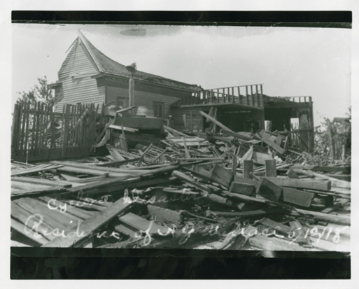
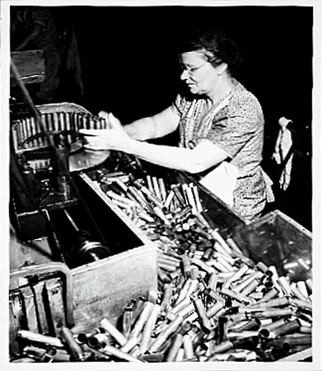
Specific Record Types: Photographs
Portraits
Family
People
Places
Events
Photograph albums

Slide 50
Specific Record Types: Writings (manuscripts/typescripts)
Writings by [creator]
  Notebooks
  Type of writing
Writings about [creator]
Writings by others

Slide 51
Specific Record Types: Additional/Other papers
Catch all
Usually arranged alphabetically by type of material.

Slide 52
Exercise #3
Organizational records - additions

Slide 53
Physical Arrangement

Slide 54
Physical Arrangement: Sorting
Process to the appropriate level
Sort first by record type or series
Keep refining
Don’t forget to label boxes

Slide 55
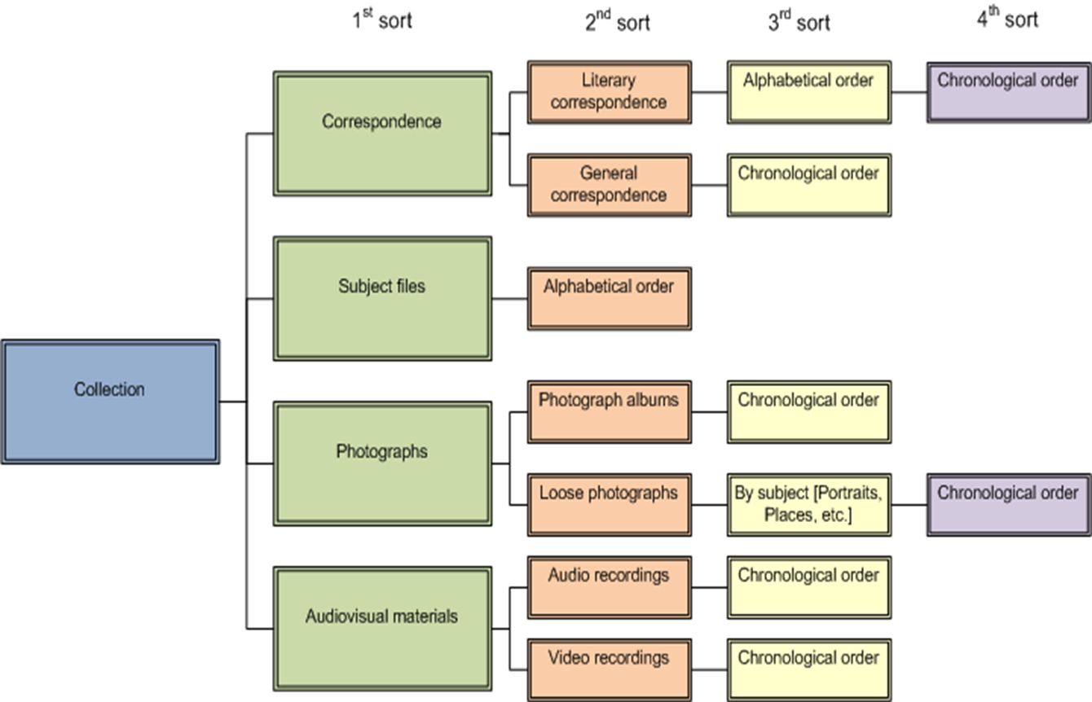
Sorting

Slide 56
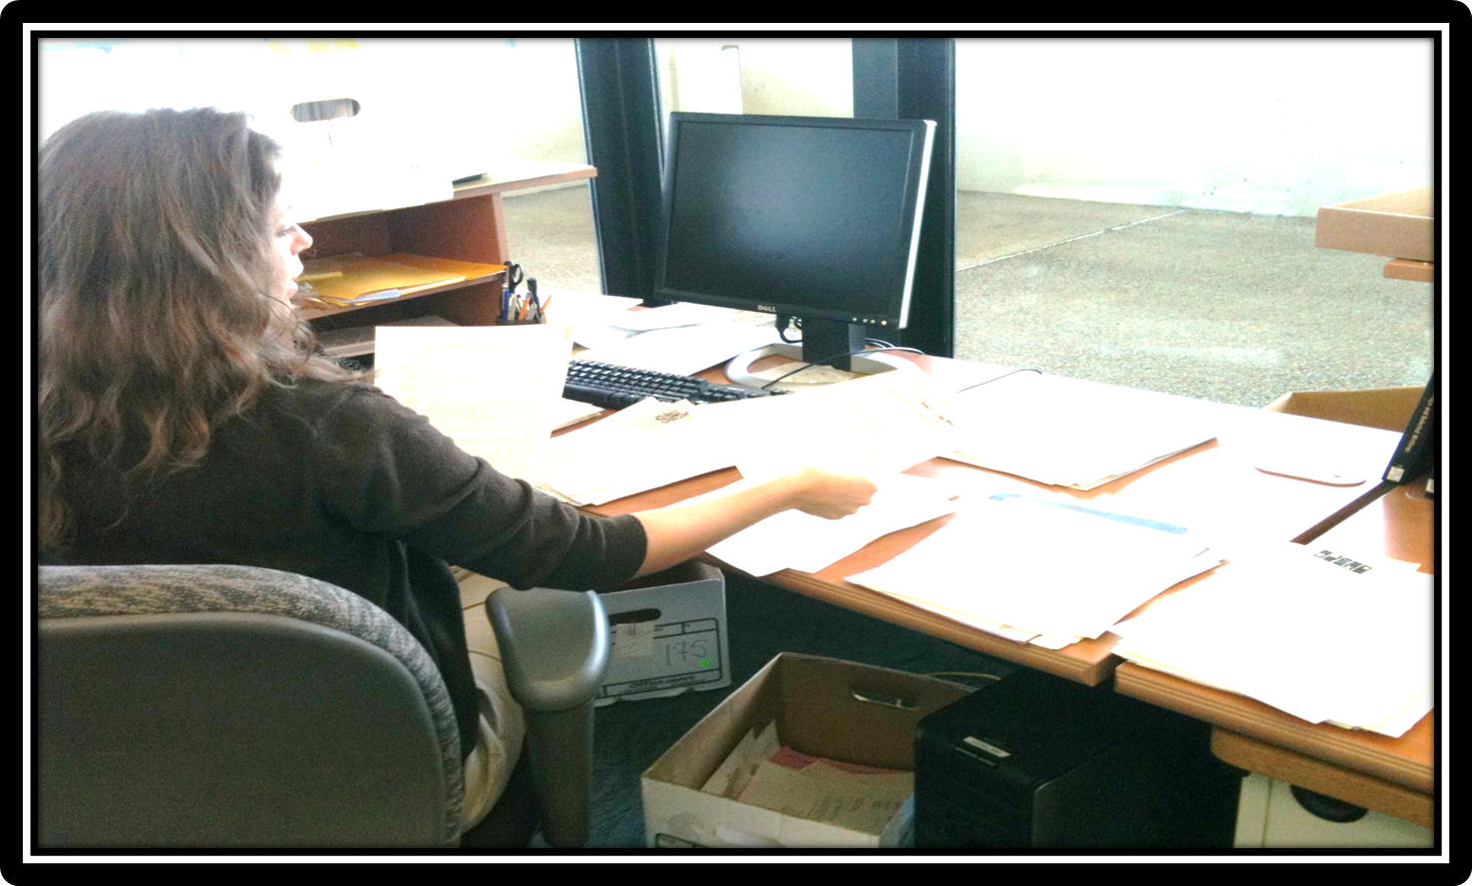

Slide 57
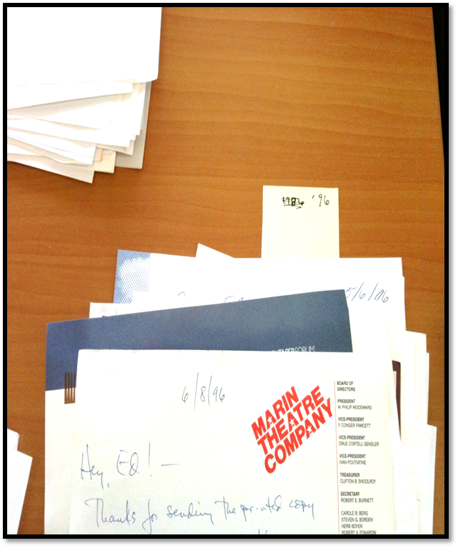
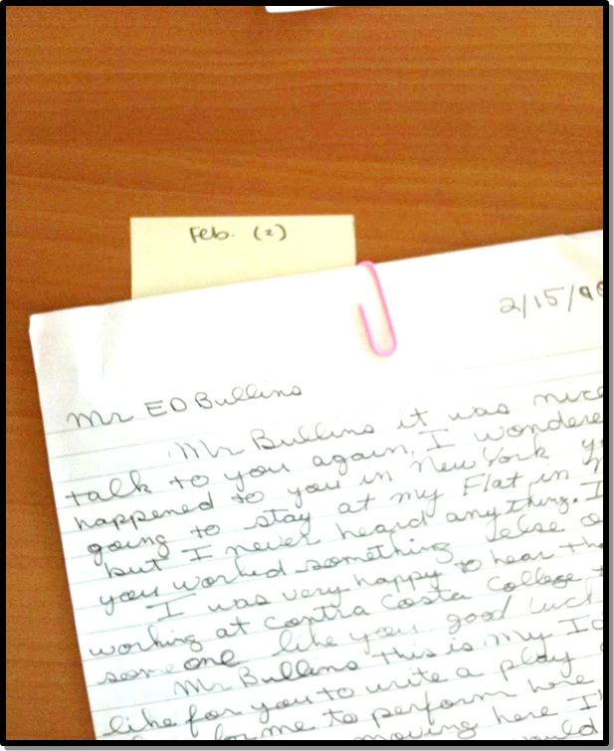

Slide 58
Physical Arrangement:
Collecting Descriptive Notes
Careful note taking
Collect information:
  Creator of collection
  Subject content
  Functions documented
  Major correspondents
  Significant people, events and places
Don’t forget to note:
  Collection strengths
  Collection weaknesses
  GAPS!!

Slide 59
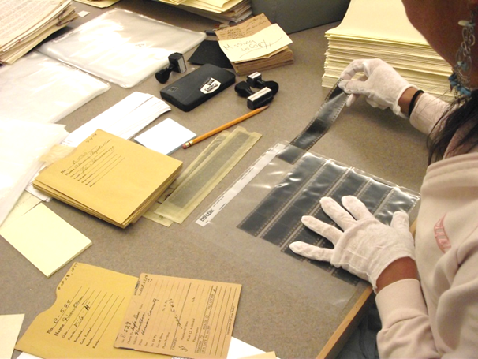
Physical Arrangement:
Separating Materials
Access and preservation considerations
  Photographs
  Audio/visual materials
  Electronic records
  Printed materials
  Restricted materials

Slide 60

Physical Arrangement: Weeding
Any material NOT deemed permanently valuable
Do not place weeded materials in office trash
Keep at least 2 copies

Slide 61

Physical Arrangement:
Restricting Materials
Donor imposed restrictions
Archivist imposed restrictions
  Fragile materials
  Protection of privacy

Slide 62
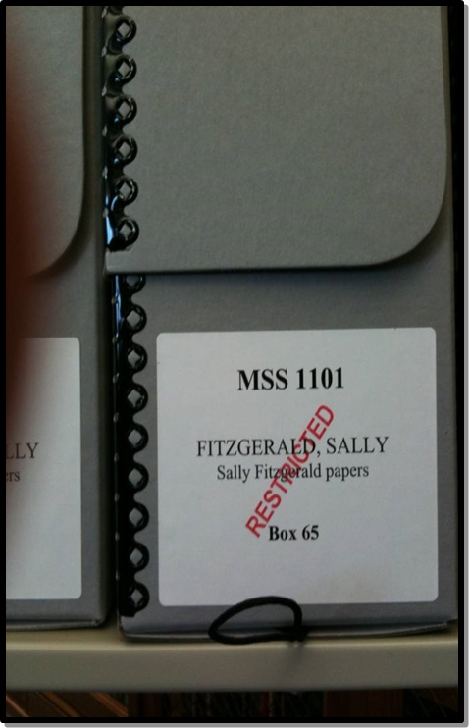
Series 2: Correspondence, Family, 1928-1967 RESTRICTED
  Box 38: RESTRICTED, 1928-1949
  Box 39: RESTRICTED, 1950-1960
  Box 40: RESTRICTED, 1961-1967

Slide 63
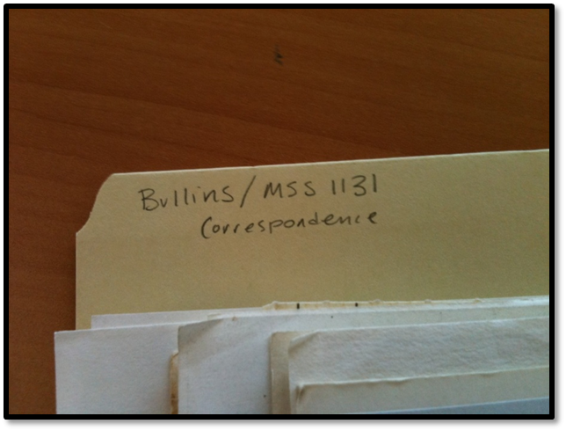
Physical Arrangement:
Preparing File Labels
File folder tab
  Last name/MSS#
  Series/subseries title
  Contents
  Box/File folder #

Slide 64
Physical Arrangement:
Preparing Box Labels
Jay L. Bate papers
MSS 129
II. Correspondence
Box 12
Box label
  Full name of collection
  MSS #
  Series title
  Box number

Slide 65
Additional Techniques

Slide 66
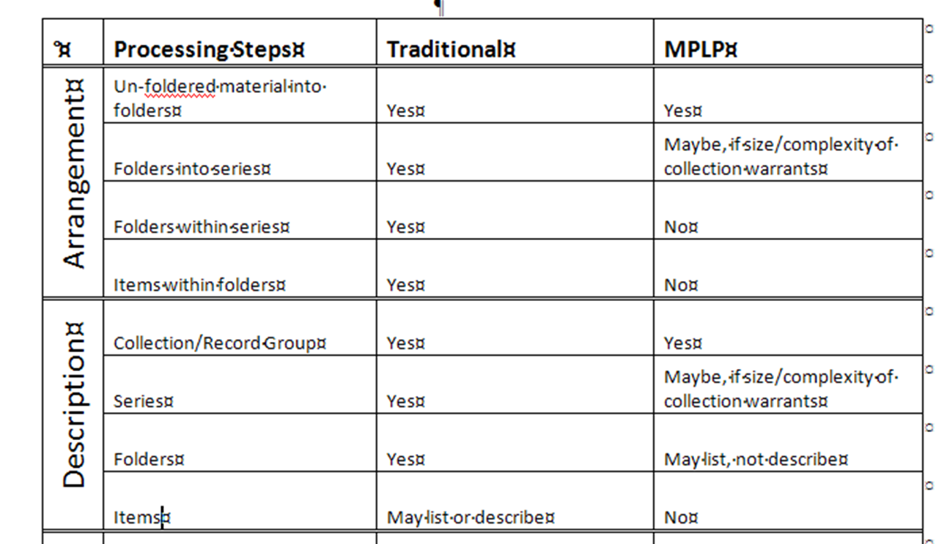
More Product, Less Process

Slide 67
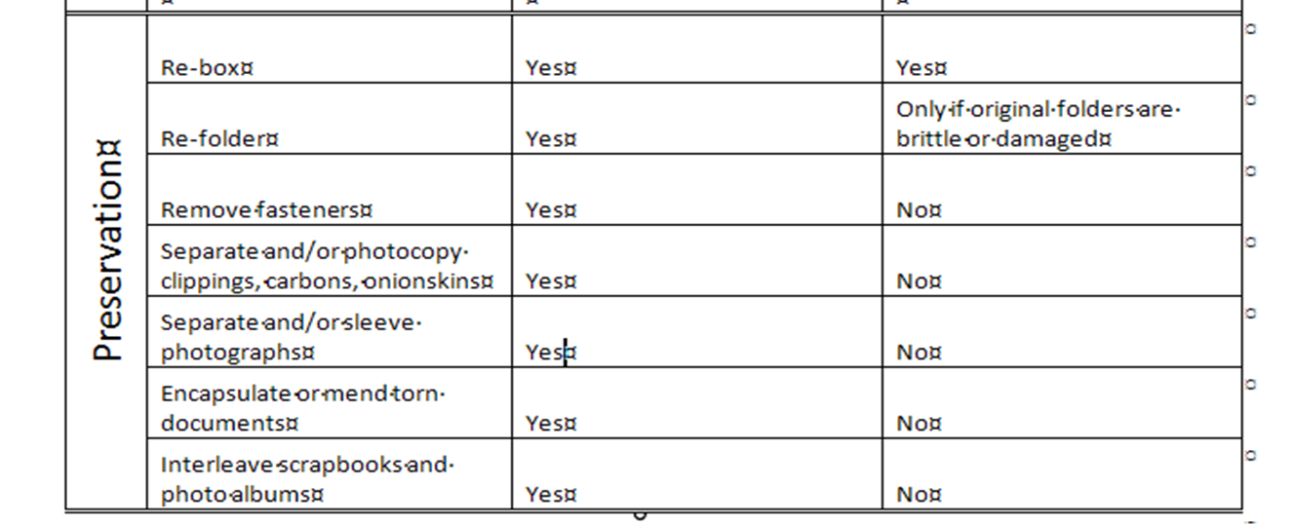

Slide 68
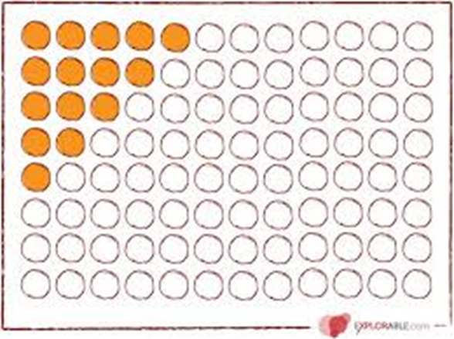
Sampling
Archival considerations
Research use and historical value
Institutional resources

Slide 69

Preservation during processing
Cleaning and repair
Remove rubber bands, plastic folders, twine, etc.
Post-it notes
Acidic paper
Metal fasteners
Folded and rolled documents
Photographs
Fragile items

Slide 70

??Questions??

